Slide 1
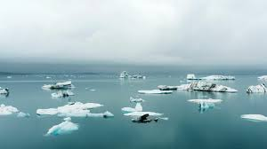
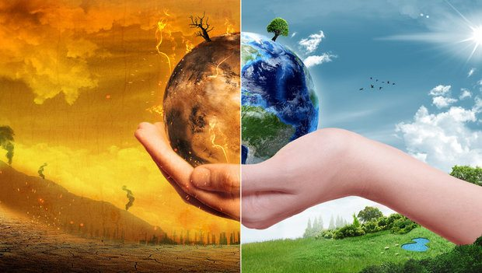
GOLBAL WARMING
CLIMATE CHANGES

Slide 3
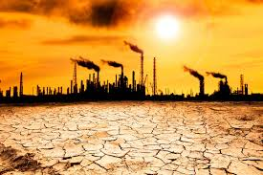
GOLBAL WARMING
Global warming is the long-term heating of Earth's surface observed since the pre-industrial period (between 1850 and 1900) due to human activities, primarily fossil fuel burning, which increases heat-trapping greenhouse gas levels in Earth's atmosphere. This term is not interchangeable with the term "climate change."

Slide 4
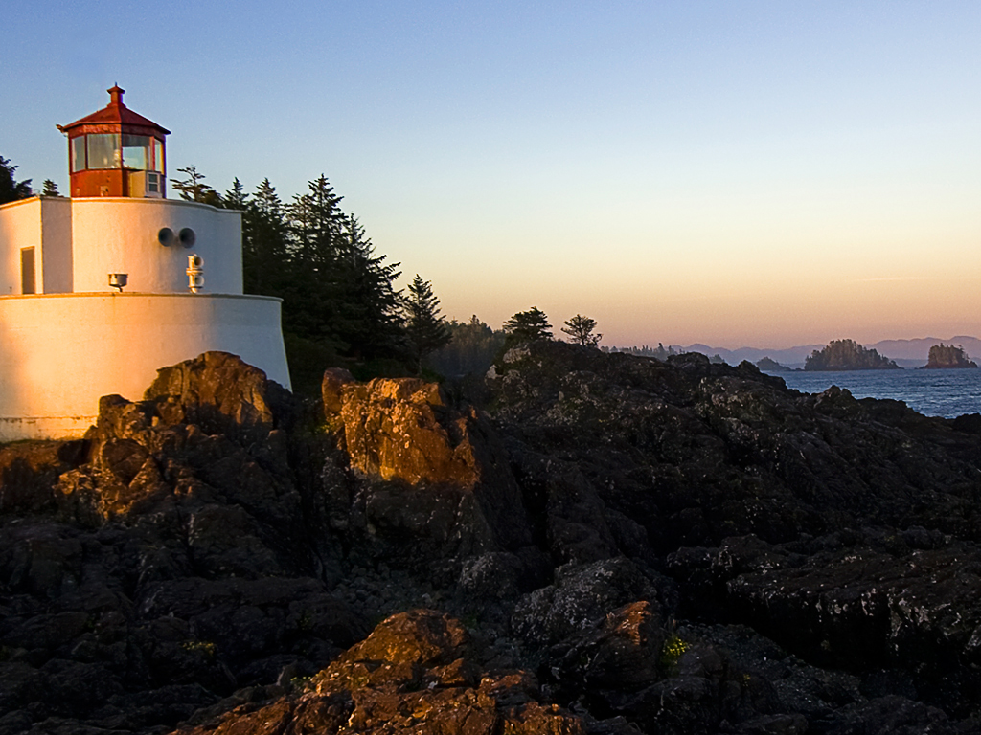
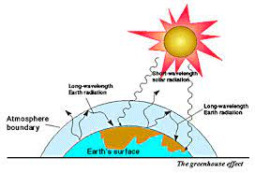
CAUSES GLOBAL WARMING EFFECT?
Air pollution.
Disease.
Extreme weather events.
Forced displacement.
Pressures on mental health.
Poor nutrition in places where people cannot grow or find suffcient food.

Slide 5

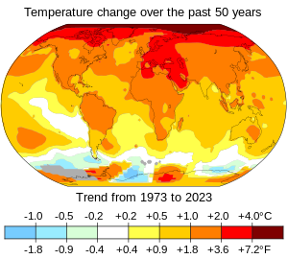
Top 10 things you can do about climate change
1.Urge Government To Take Bold, Ambitious Climate Action Now. ...
2.Use Energy Wisely — And Save Money. ...
Green Your Commute. ...
3.Consume Less, Waste Less, Enjoy Life More. ...
4.Support Indigenous-led Climate Action. ...
5.Invest In Renewables And Divest From Fossil Fuels. ...
6.Eat For A Climate-stable Planet.

